Slide 1
RED TEAMING
Your first physical engagement
Presentation by David Probinsky for BSides Orlando 2023

Slide 2

DISCLAIMER
All the information provided with this presentation is for educational and informational purposes only; and is made available to you as self-help tools for your own use.
The misuse of the information on this presentation can result in criminal charges brought against the persons in question. The authors, presenter, and the BSides Conference will not be held responsible in the event any criminal charges be brought against any individuals misusing the information in this presentation to break the law.

Slide 3
# whoami
- Red Team Lead | Offensive Security @ Elevate Consult
- Red Teaming | Physical Security | Social Engineer | Ethical Hacking
- InfoSec Professional with over 7 years of experience on IT & Offensive Security.
- AS in Computer and Network Security, currently pursuing BAS
- Network+, Security+, PenTest+, eJPT, and a few others
- Proud and active member of Hack Miami (%27), InfraGard, South Florida Information Systems Security Association (SFISSA), DCG561, The Open Organization Of Lockpickers (TOOOL), and RedTeamRD from the Dominican Republic.
- Presented at HackMiami, RedTeamRD, EkoParty, Texas Cyber Summit, and appearance on a documentary by Telemundo.
- DC30 Red Alert ICS CTF 🏆

Slide 4
Topics
Red Team
Recon
PhySec
Social Eng.
Overview
PenTesters
Red Team Operators
OSINT
HUMINT
IMINT
Overview
Common tools
Tips and tricks
Overview
Pretexting
Scenarios

Slide 5
Red Team
01
Are we Red Teaming, or just Pentesting?
PenTesters Vs Red Team Operators

Slide 6
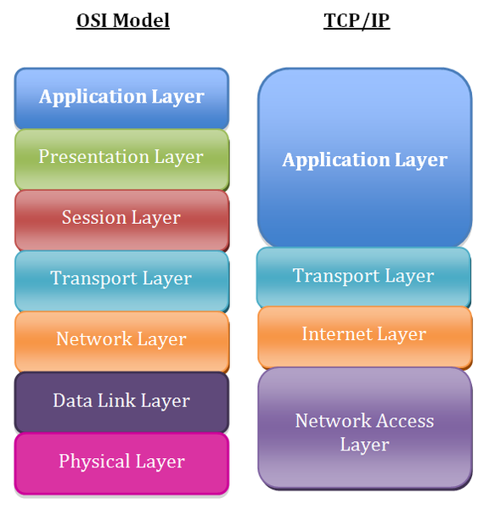
🤔Why not? →

Slide 7
“That wont be in Scope/Budget…”
— Your client
“Offices are empty, nobody there…”
— Your client
“We’ve never had a break-in…”
— Your client
“...”
— You
“...”
— Your boss
“...”
— APT reading the emails

Slide 8
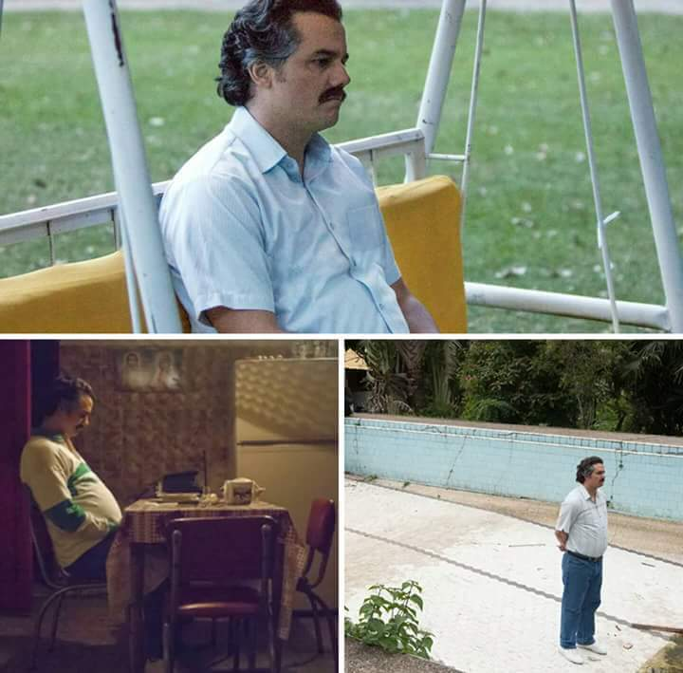

What if your target is air-gapped?

Slide 9
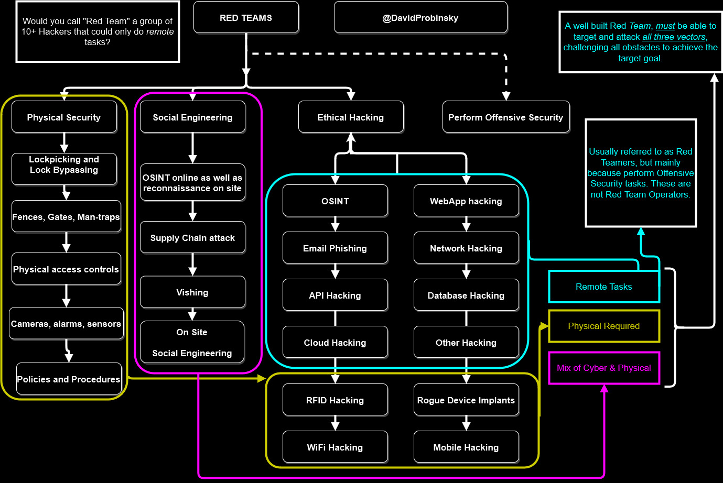

Slide 10
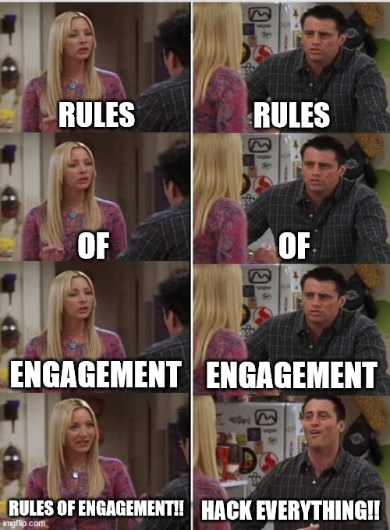

Slide 11
Reconnaissance
02
OSINT, HUMINT, and a bit of IMINT

Slide 12
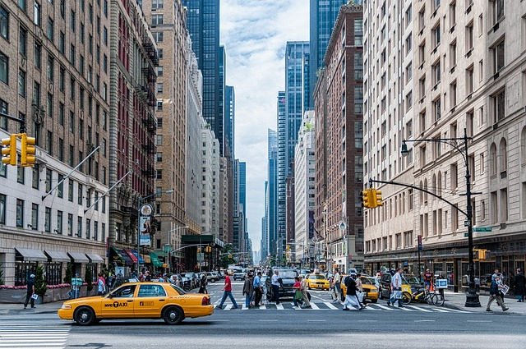
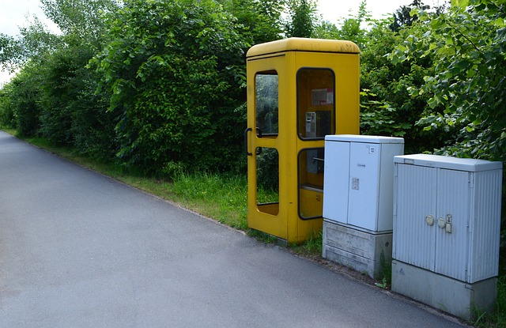
OSINT
Target and affiliated entities.
Offices or facilities, their other locations.
Types of Infrastructure:
Street View, Blueprints, Real Estate, Property management.
Local vs Remote locations.
Social Media events:
Building/facility layout.
Cameras & security systems.
Uniforms and Company Logo.
Company vehicles.
Google is your friend!

Slide 13
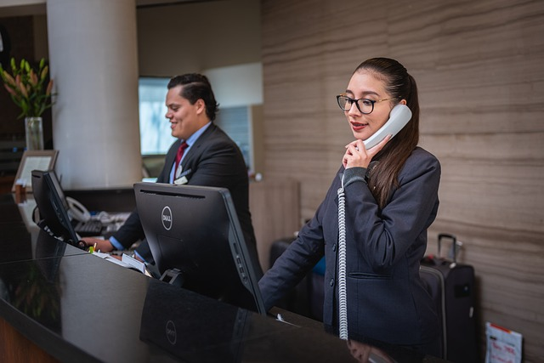
HUMINT
Nearby coffee shops, food shops, or parks.
Chatting with unsuspecting employees.
Human Resources, are they hiring? (More in Social Eng)*
Foot traffic at day/night.
Security Guards, Maintenance, Cleaning crew, Delivery.
Third party suppliers/employees, visitors.

Slide 14
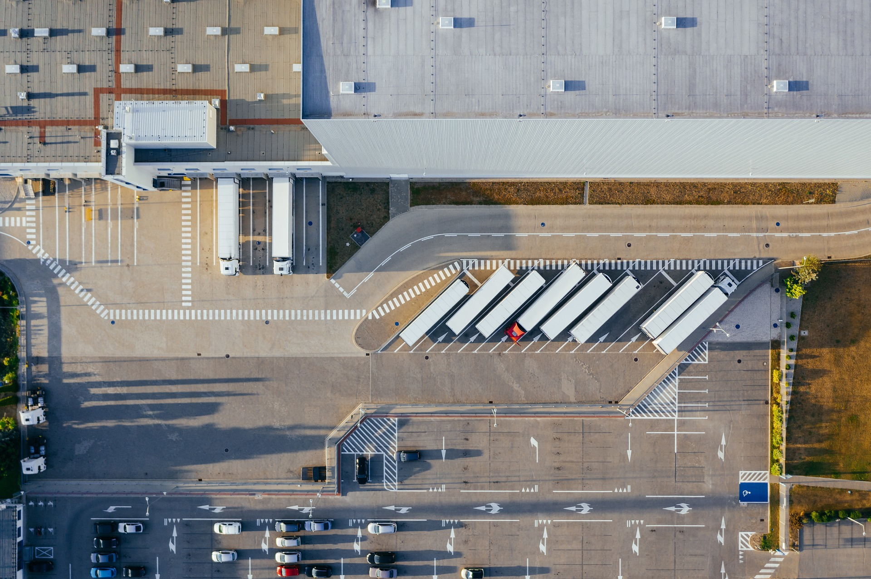
IMINT
Fences, gates and locks.
Mantraps, Biometrics, RFID.
Security Cameras and other sensors.
Fire escapes and all entry and exit points.
Roof access.
Pictures, pictures, and more pictures. (Video too)
Stealth is key.

Slide 15
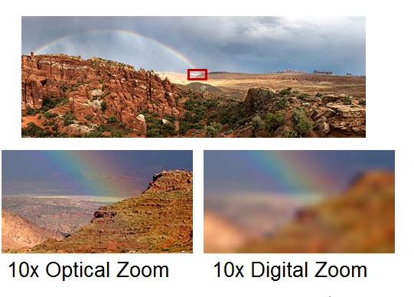
Source: https://blog.camcloud.com/digital-zoom-vs-optical-zoom/

Slide 16
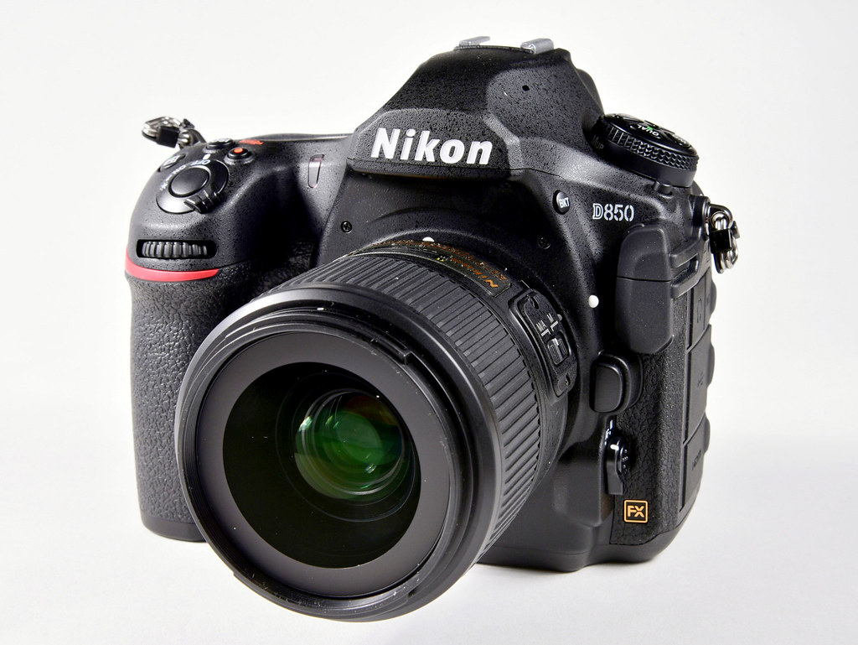
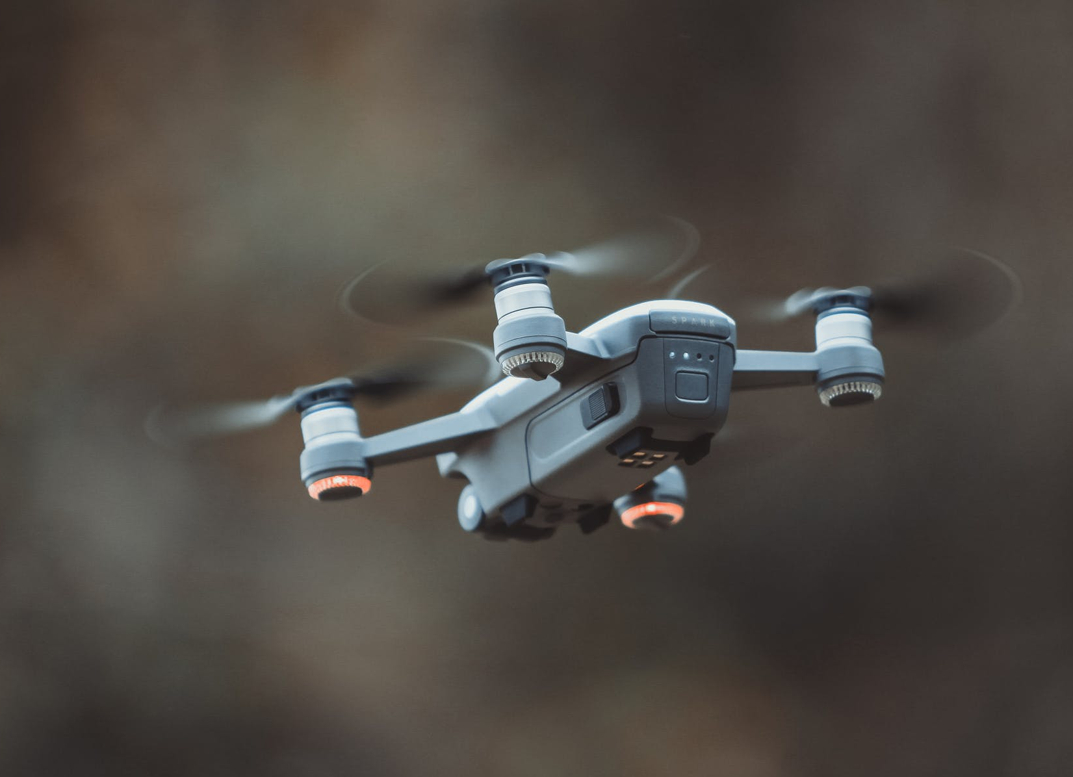

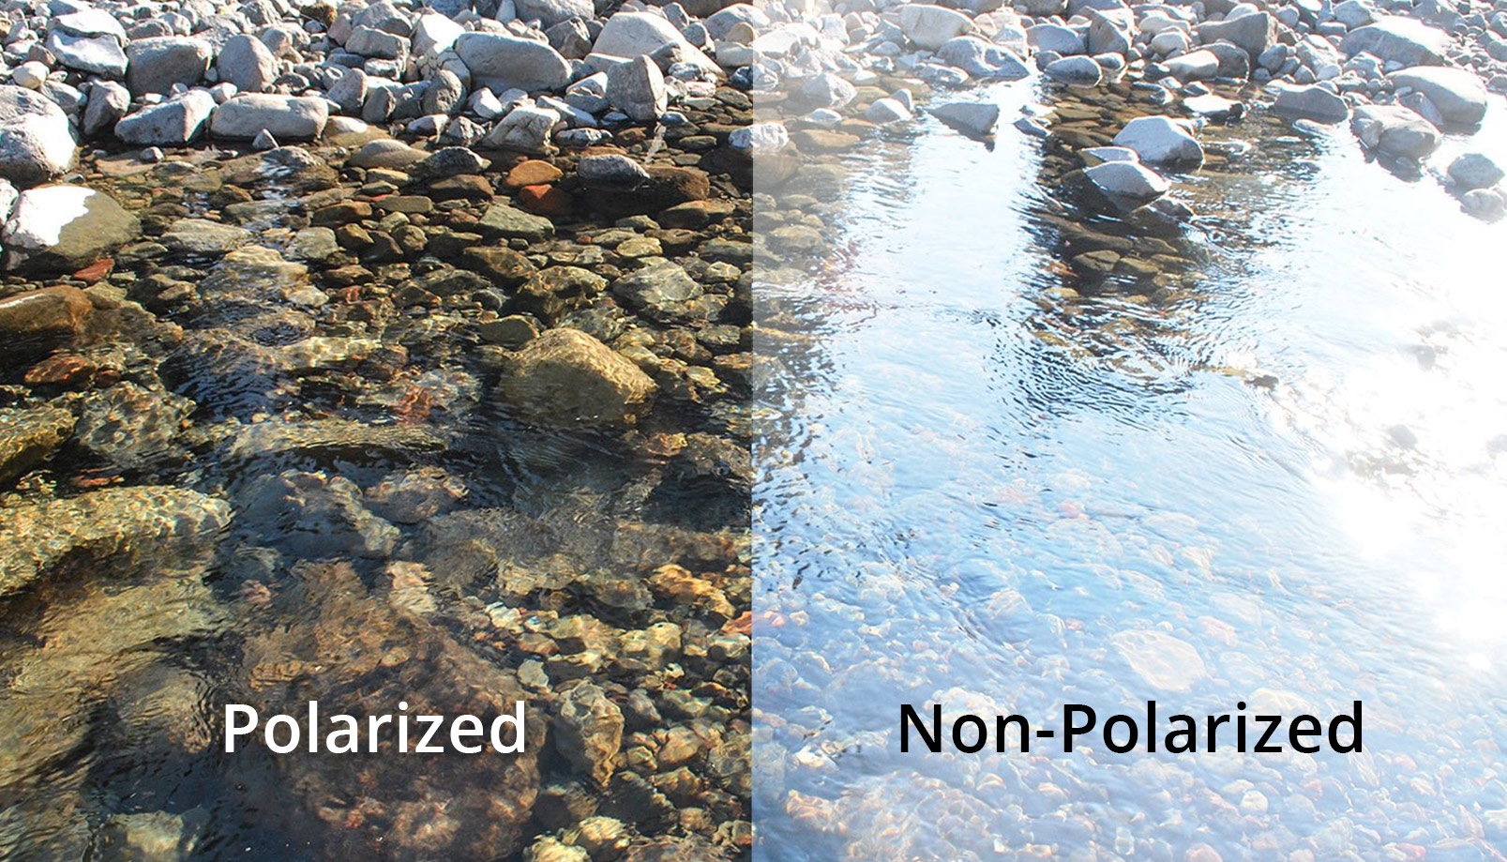
Source: https://www.blinkvision.com/wp-content/uploads/blink-vision-blog-polarized-lenses-final.jpg

Slide 17
PhySec
03
Overview, common tools, tips & tricks

Slide 18
01
02
03
Medical
ICS/Scada
Law firms
PhySec Overview
Massive amount of foot traffic on prem
Very likely to have hubs in remote locations
A lot of foot traffic and store a lot of documents on prem
Metcalf Electric Grid Attack: https://youtu.be/GlGI643vUIg

Slide 19
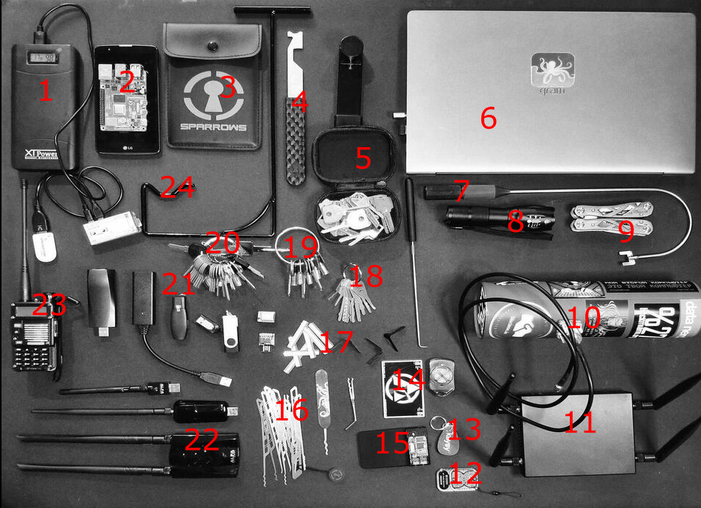
Power Bank
Cellphone (Ideally with Kali)
Plastic shims
Jim
Bump keys
Laptop
Thumb turn tool (J-Tool)
Flashlight
Multi-tool
Cantenna for long range WiFi
WiFi Pineapple
RFID Frecuency detector
Keysy RFID
RFID Frecuency detector
Proxmark
Lockpicks
Lock and core shims
Jigglers
Elevator keys
Other default keys
Your USB implants 😈
WiFi dongles (yes, multiple)
Radio – Comms with the team
Double Door Tool https://github.com/DavidProbinsky/RedTeam-Physical-Tools
- Not displayed: Under the door tool, Can of air, Lishi tolos, batteries, drone, and a few others.

Slide 20
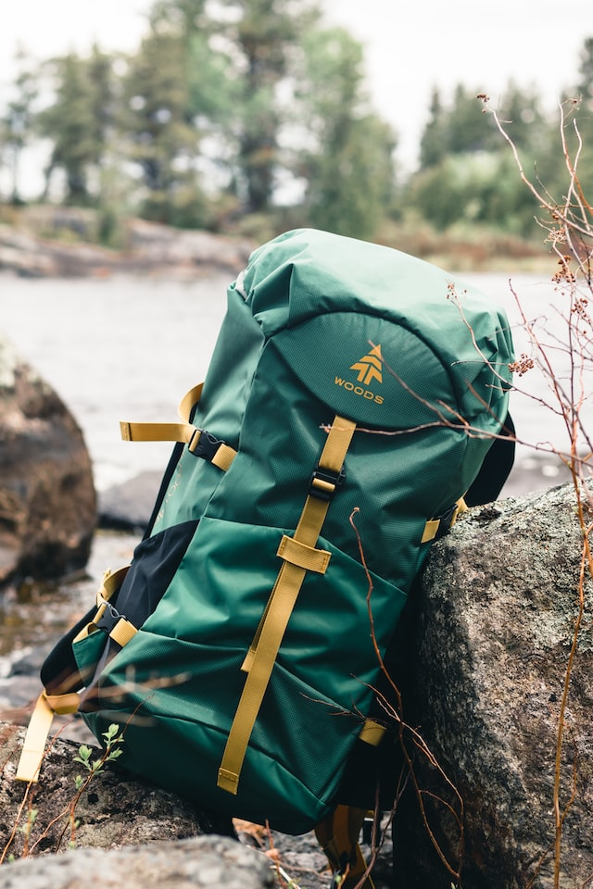


Slide 21

Other items
Authorization form (Obviously)
The direct contact at your target company
Bodycams and other cameras
Hand sanitizers
Water and candy
Bandaids and alcohol
Some form of ID (The real one)
Cellphone and emergency contacts
T.P.

Slide 22
Social Eng.
04
Overview, Pretexting, Scenarios

Slide 23
Social Engineering
Not limited to a phishing email
Barely requires any tools
Must have a sharp memory
Must have an eye for details
Must have a solid pretext
Be able to read body language

Slide 24
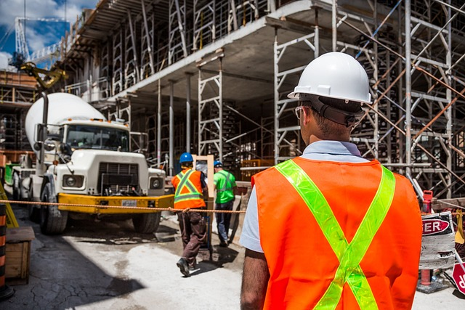
Pretexting
Solid pretext
Backup pretext
HR Hiring? Interview/Tour
Fake alias/profile
Fake ID badges
Props!

Slide 25
Attire
Urban
Rural
Keep it formal
No flashy colors
Avoid drawing attention
Camo? Why not?
Dressed Down/Rugged
More comfortable

Slide 26
Scenarios!
The AT&T Tech
Real Estate Agent
Delivery guy

Slide 27
A TIMELINE ALWAYS WORKS WELL
DAY 1
Day 5
DAY 3
DAY 7
Night Recon
Go time!
Daytime recon
Prepare gear and practice

Slide 28
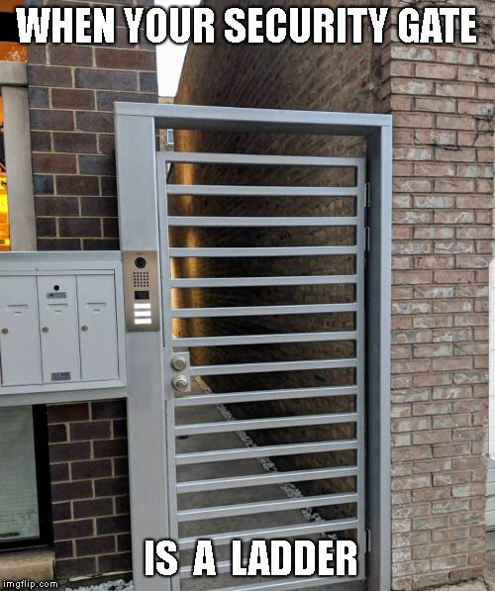
THANKS!
Do you have any questions?
@DavidProbinsky if the blue bird doesn’t die
0xOverflow#1337 on Discord
@DavidProbinsky@infosec.exchange
https://www.linkedin.com/in/davidprobinsky/
https://github.com/DavidProbinsky/RedTeam-Physical-Tools
www.ElevateConsult.com

